Slide 1
An introduction to Raspberry Pi & Python Programming
Mr Martin Thong
Mr Wong Kim Siong
Robotics Connection Pte Ltd
Updated on August 2016

Slide 2
Course objectives:
Be familiar with the Raspberry Pi Hardware
Learn basic python commands
Understand circuit diagrams and assemble them
Use python to control RPi GPIOs
Use RPi to control a robot car, GoPiGo

Slide 3
6-lesson Agenda
Lesson 3
Nested if…else…
Programming buttons as an input to ON/OFF LEDs
Programming buttons to control LED brightness
Lesson 4
Programming the Raspberry Pi to control a robot car
Use of touch sensor, ultrasonic sensor, colour-sensor
Remote-control

Slide 4
Nested if…else…
There are situations that you will need to make decision based on two or more conditions, where outcome of one condition determines the next condition to check. So we use the nested if…else…

Slide 5
Example:
The table below determines whether a person is eligible to play a particular sport based on gender and age.
Gender | Cannot Play | Can Play
Male | Age above 21 | Age 21 & below
Female | Age above 18 | Age 18 & below

Slide 6
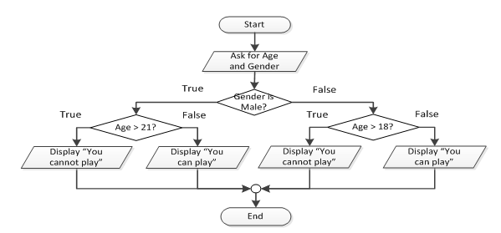
Flow chart Illustration

Slide 7
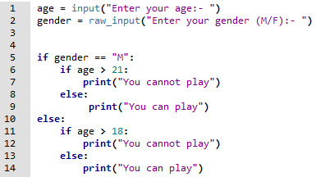
Code according to flow chart

Slide 8
Programming Challenge 10
Write a program to check and display if a person is allowed to participate in a contest based on the person’s gender and age according to the table below:
Gender | Allowed | Not Allowed
Male | 21 years and above | Below 21 years
Female | 18 years and above | Below 18 years

Slide 9
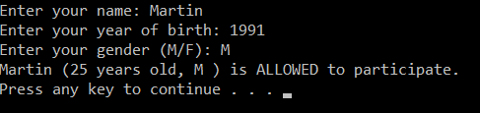
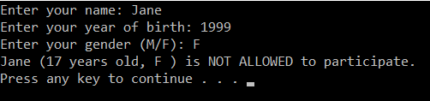
Sample outputs

Slide 10
Programming Challenge 11
Write a program that determines whether a bank customer qualifies for a loan.
To qualify, 2 conditions must be satisfied:
the customer must earn at least $30k p.a.
The customer must be employed at current job for at least 2 years.

Slide 11



Sample outputs

Slide 12
Programming Challenge 12
A department store is running a promotion event for their customers who purchase above $100.
If the customer pays by credit card, they get discount of the total price as follows:
DBS/POSB credit cards – 10% discount
OCBC/OUB credit cards – 15% discount
Write a program that asks the user for the total cost of purchase, whether paying by credit card and bank of credit card if paying by credit card.

Slide 13
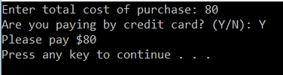
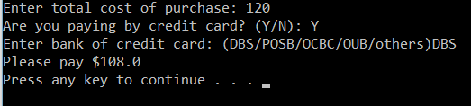
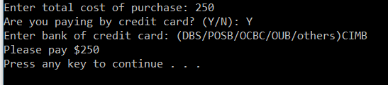
Sample outputs

Slide 14
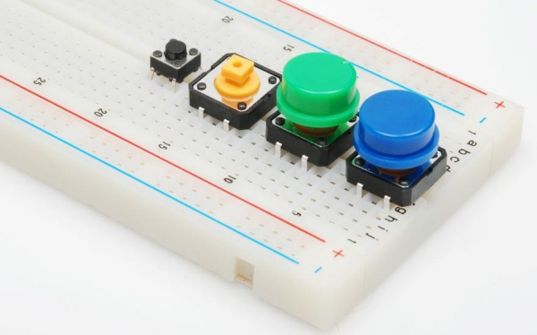
Button
A button is a momentary switch that remains ON when pressed. If it is not pressed, it will be OFF.

Slide 15

Let’s build this circuit
We are going to use the BOARD mode and use the button to ON/OFF the LED.
The LED will remain ON as long as the button is pressed. No programming needed.
Button with green cap
330 $Ω$
3.3 V
physical pin 1
Green LED

Slide 16
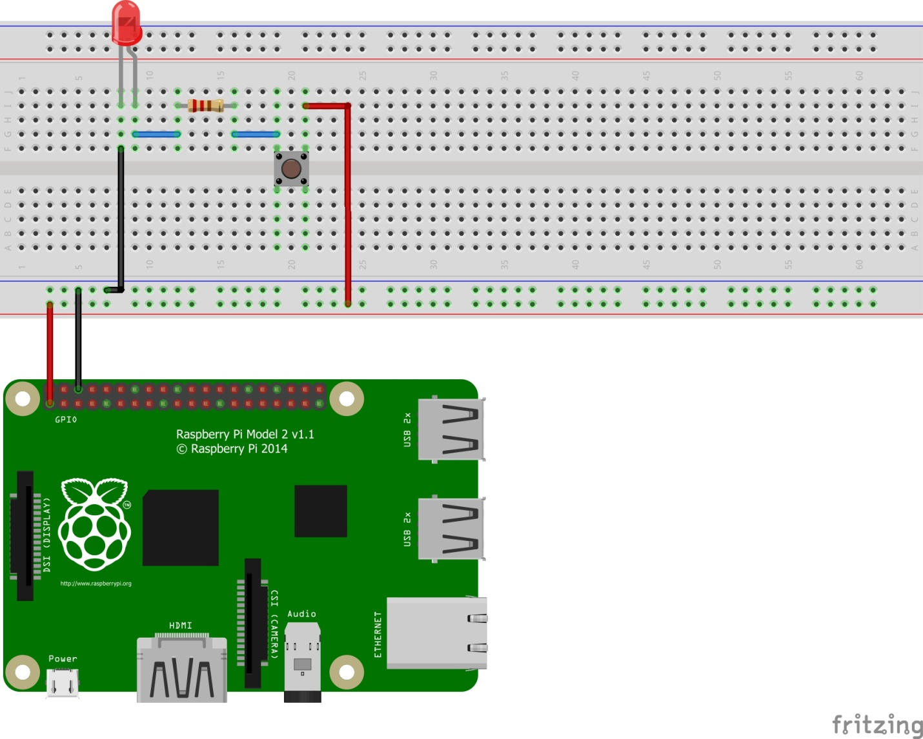
Did your circuit looks like this?
Pin 1 – 3.3V
Pin 6 - GND

Slide 17
Modifying the circuit
Now we are going to change the function of the button.
We are going to program the button such that it will alternate ON/OFF each time it is pressed.

Slide 18
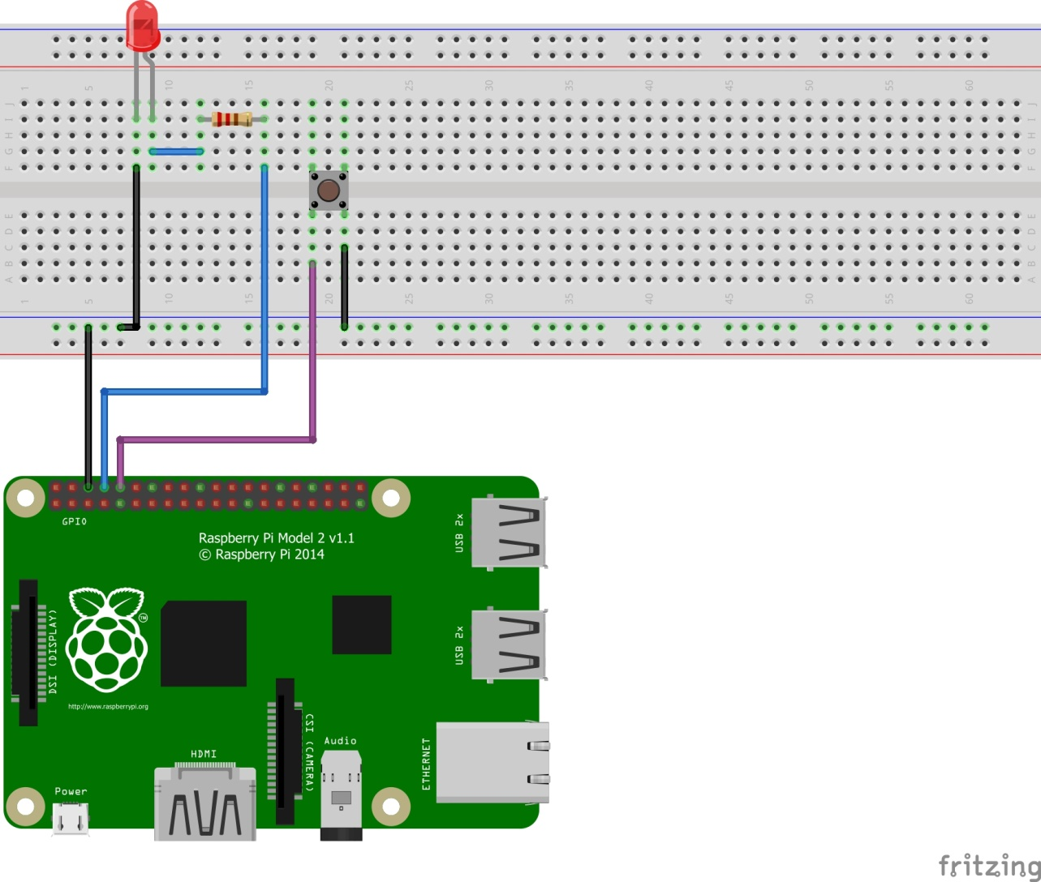
Setup your circuit like this

Slide 19
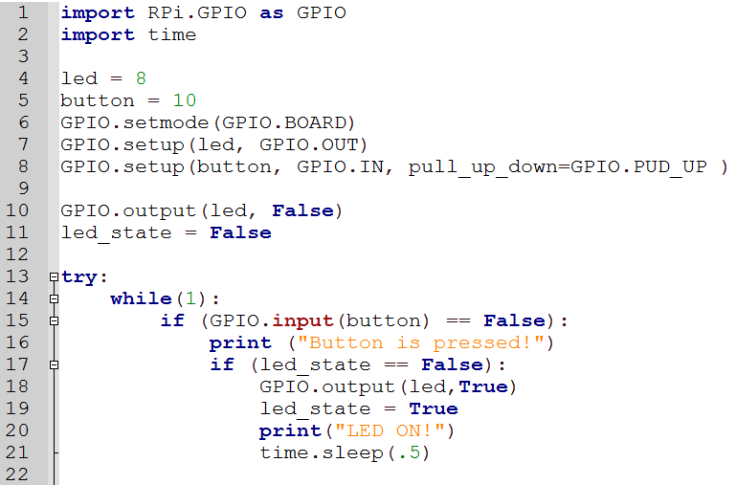
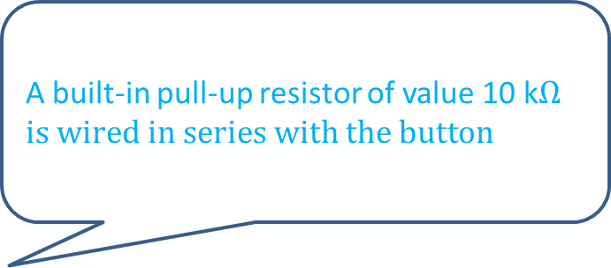
Let’s program it! 1
A built-in pull-up resistor of value 10 k$Ωis wired in series with the button$

Slide 20
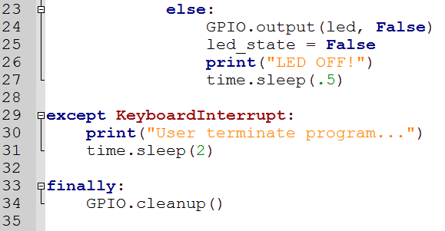
Let’s program it! 2
What do you think is the function of time.sleep() in this program?

Slide 21
RPi Challenge 5
Program the button such that each time it is pressed, the LED will light up for 5 seconds.

Slide 22
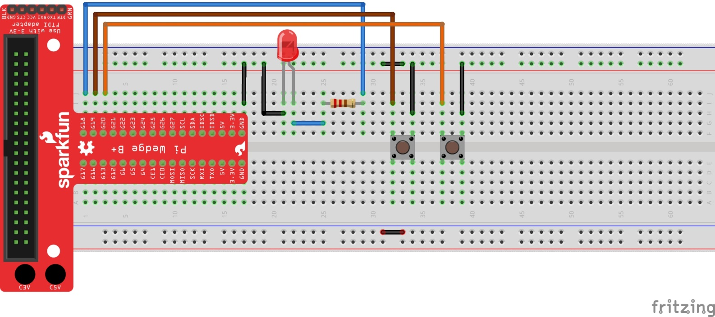
Programming 2 buttons ON/OFF LED
Setup the circuit below

Slide 23
RPi Challenge 6
A) Program such that the left button will ON the LED and the right button will OFF the LED.
B) Program such that the LED will only light up when both buttons are pressed simultaneously.

Slide 24
RPi Challenge 7
As a design engineer, you are tasked to design and program a lighting system for a 100m walk-way. You are to install a power lamp every 25m, a switch at the 0m and 100m mark. The switches should work in the following manner.
If switch S1 (at 0m) is pressed, the lamp will on in the following manner. Lamp L1, lamp L2, then lamp L3 where L1 is at 25m, L2 is at 50m and L3 is at 75m. If it is pressed to off, it will off in the order L3, L2, L1. There is a difference of 2 seconds between switching on/off of each lamp.
If switch S2 (at 100m) is pressed, L3 will on, followed by L2 and L1. If the lamps are already on, then L1 will off, followed by L2 and L3.

Slide 25
Pulse Width Modulation (PWM)
So far we have programmed the LED to be one of 2 states, ON or OFF.
With PWM, we can set the brightness of the LED. ie set brightness to 20%, 50%, etc… by controlling the duty cycle.
Duty cycle of 0% - OFF
Duty cycle of 100% - ON

Slide 26
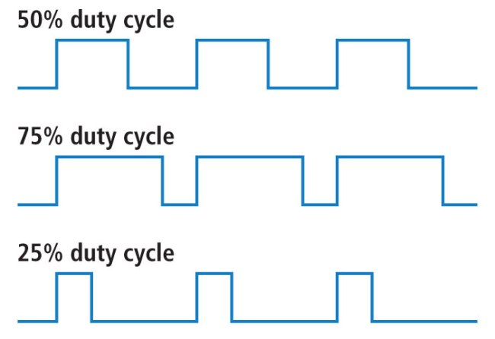
Duty Cycle
We will set the left button to decrease the duty cycle and the right button to increase the duty cycle. With that we can control the brightness of the LED
We can set our LED to have 5 states.
0, 25, 50, 75 or 100 % brightness

Slide 27
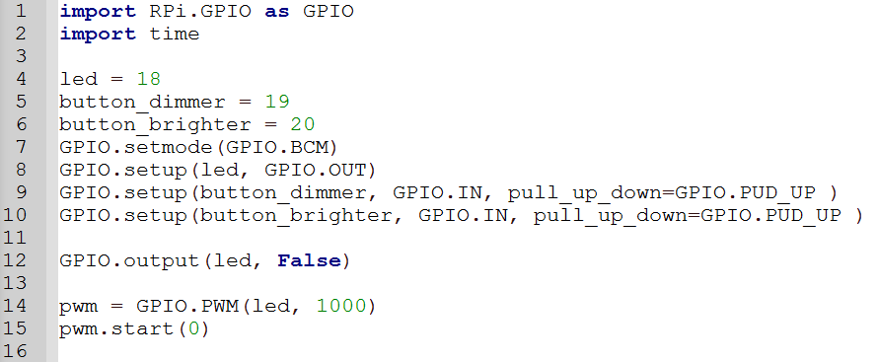
PWM codes 1
sf

Slide 28
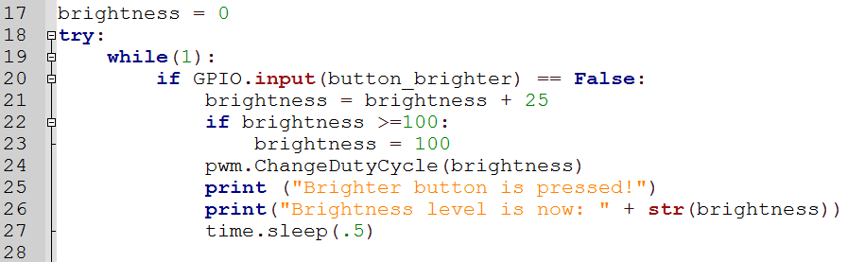
PWM codes 2
The codes given is to increase the brightness of the LED. Can you add in the codes to decrease the brightness?

Slide 29
WIFI
You can connect to your Local Area Network (LAN) through wifi
Click on the wifi symbol on the top right and connect to your private network
Note down the IP address as we will need it later.

Slide 30
Update your RPi
Launch Terminal
Type: sudo apt –get update
This will update the system’s package
Type: sudo apt –get dist –upgrade
This will upgrade all installed packages to their latest version
Notes:
Similar to windows update

Slide 31
Virtual Network Computing (VNC)
Allowing the access of RPi by another device connected via the internet or network
VNC is a graphical desktop sharing system
It transmits keyboard and mouse events from the client to the server and updates the screen
With VNC, we never have to hook up to a monitor, mouse and keyboard again.
Server – RPi
Clients – desktops, laptops, phones, etc…

Slide 32
Installing and setting up the server
Launch Terminal from your GUI
Type: sudo apt –get install tightvncserver
This will install the vnc server on the RPi
Type: tightvncserver
This will setup your password for your vnc server
The password can be at MOST 8 characters long

Slide 33
Autostart VNC at boot 1
In Terminal, type: cd/home/pi to go to the home directory
Type: cd .config to go into the hidden config directory
Type: sudo mkdir autostart to create a new folder named “autostart”
Type: cd autostart to go into the autostart folder
Type: sudo nano tightvnc.desktop to create a new configuration file that will start VNC upon bootup

Slide 34
Autostart VNC at boot 2
Type exactly the words below into the text file:
[Desktop Entry] Type=Application Name=TightVNC Exec=vncserver:1 StartupNotify=false
Press Control + O to save and Control + X to exit the text editor.
Now RPi will start VNC server every time it boots
Notes:
vncserver :1 -geometry 1920x1080 -depth 24 -dpi 96

Slide 35
Installing and setting up the client
Go to the link below and download a suitable version for your OS
http://www.tightvnc.com/download.php
Install it and an icon should appear on your desktop
Click on it and type in the IP address assigned to your RPi followed by :1 eg. 192.168.x.yz :1
Type in the VNC password and …TADA!!!

Slide 36
Assemble GoPiGo
Refer to the pdf file and watch the videos on your laptop on how to assemble the GoPiGo.

Slide 37
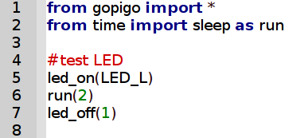
LED control
Try the sample codes to understand how to control the LED
Which LED are we controlling? How do we control the other LED?

Slide 38
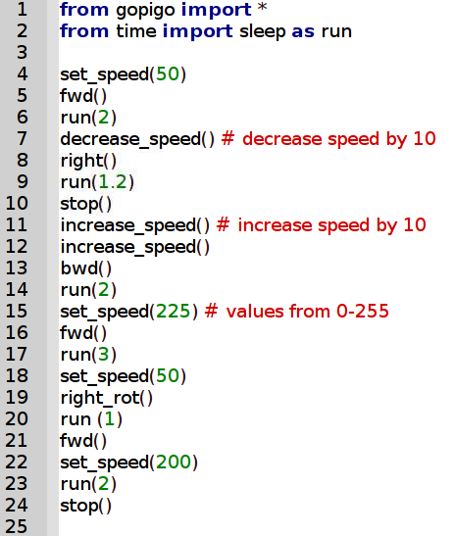
Motor Control
Try the sample codes to understand how to control the motor
Do you know the difference between right() and right_rot()?
How to make a 90º right turn?

Slide 39
Mouse Control
How to use mouse to control your GOPIGO.

Slide 40
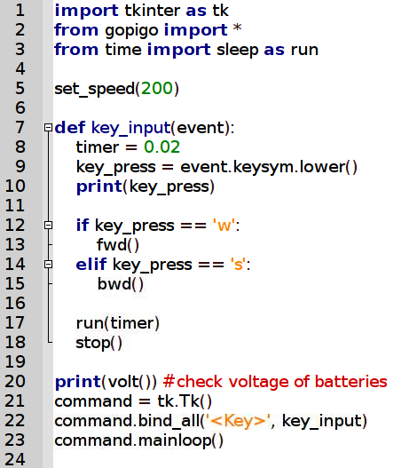
Remote Control
Try the sample codes for remote control
Can you add in the codes for turning?

Slide 41
GoPiGo Missions
Use all the knowledge you have gained today to program GoPiGo to achieve the tasks given to you.

Slide 42
Mission 1
Program GoPiGo to go in a clockwise manner around a rectangular block. It will stop after completing 4 rounds.
The right led will light up when it is turning.

Slide 43
Mission 2
Program GoPiGo to go to a specific destination without hitting any obstacles.
Full led implementation:
Forward (both leds light up)
Right turn (right led light up only)
Left turn (left led light up only)
Backward (both leds blink)
Stop ( both leds off)

